Slide 1
Work Energy Principle
Kinetics of Particles

Slide 2
Recall
In statics, the particle (or object) is not accelerated. The external forces on the object are considered to be applied so slowly that they do not cause any acceleration of the object
In dynamics, however, the forces cause the object to accelerate. This acceleration causes inertia forces, which must be considered
Kinetics is a branch of dynamics that deals with problems which need consideration of forces causing the motion
Various principles are used to solve kinetic problems. A few of them are
Work-energy principle
D’ Alembert’s Principle
Impulse-momentum Principle

Slide 3
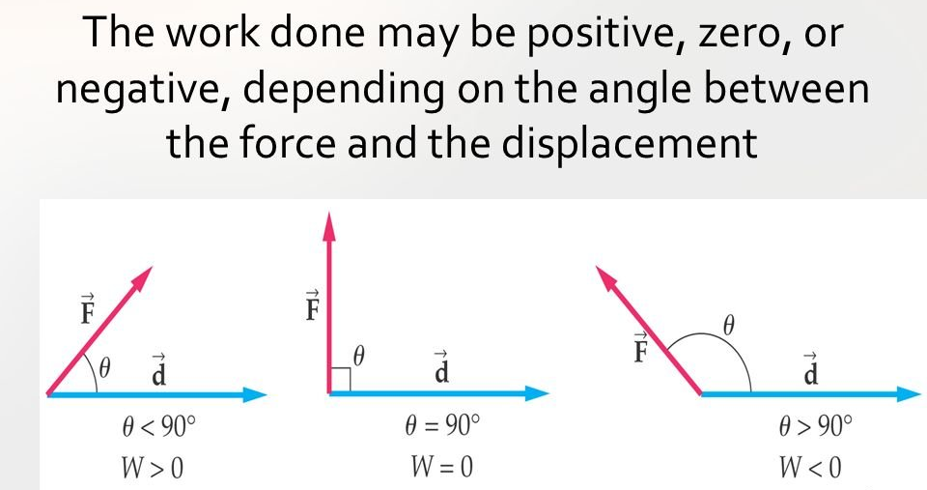
Work-Energy Principle – Introduction
Work
The work done (WD) by a force on an object is defined as the product of the force and the distance moved by the object due to the force in the direction of the force
The general expression for WD by a force P is Ps × cosθ, where θ is the angle between the line of action of the force P and the direction of motion of the object and s is the distance moved due to the application of the force in the direction of the force

Slide 4
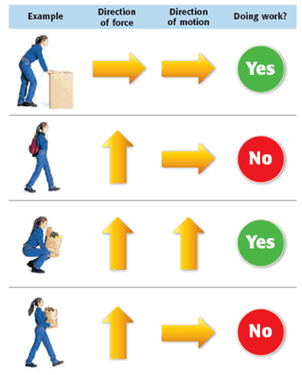
Work-Energy Principle – Introduction
The unit for WD is N-m. One N-m of WD is denoted by one Joule (J). Other commonly used units are kilo joules (kJ), which is equivalent to kN-m and milli joules (mJ), which is equivalent to N-mm

Slide 5
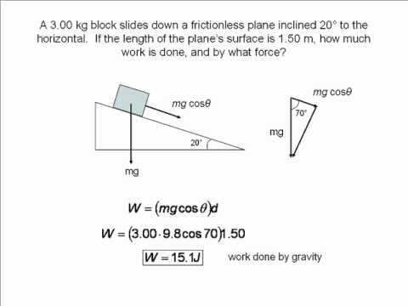
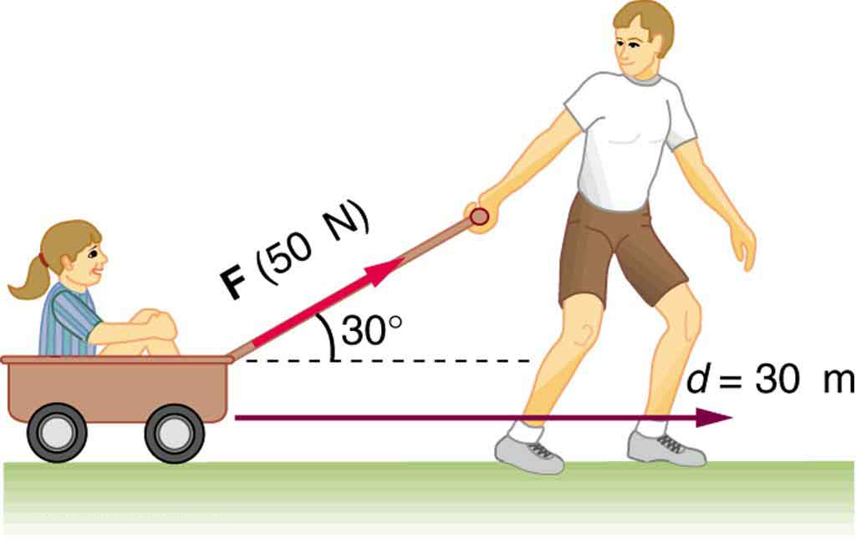
Simple problems on WD
Angle between direction of motion and the line of action of force, θ = 30°. Distance moved, s = 30m, Force applied, P = 50N
Therefore, WD = Ps × cosθ = 50 × 30 × cos30 = 1299.04 N-m or J
The solution can be thought of as – the motion is in the horizontal direction (s = 30m). But the applied force is not horizontal. Therefore, the horizontal component of the force is 50 × cosθ
Now, WD = Force × distance covered in the direction of force
WD = (50 × cosθ) × 30 = 1299.04 N-m or J

Slide 6
Energy
Energy is defined as the capacity to do work
There are many forms of energy like heat, mechanical, electrical, chemical, etc.
In engineering mechanics, mechanical energy is of interest
Mechanical energy is classified into kinetic and potential energy
PE is the capacity to do work due to the position of the body. A body of weight W held at a height h possesses a PE of Wh
KE is the capacity to do work due to motion of the body. A body of mass m moving with a velocity of v possesses a KE of ½ × mv²

Slide 7
Power
Power is defined as the time rate of doing work. It is the WD per second. i.e. p = WD/time = (Force × distance)/time = Force × (distance/time) = Force × velocity. This velocity must be in the direction of the force
Therefore, the unit of power is J/s which is written as Watt w. 1 J/s = 1 w.
Kilowatt (kw) and Horse Power (HP) are also used as units of power
1 metric HP = 735.75 watts
1 British HP = 745.8 watts

